Slide 1
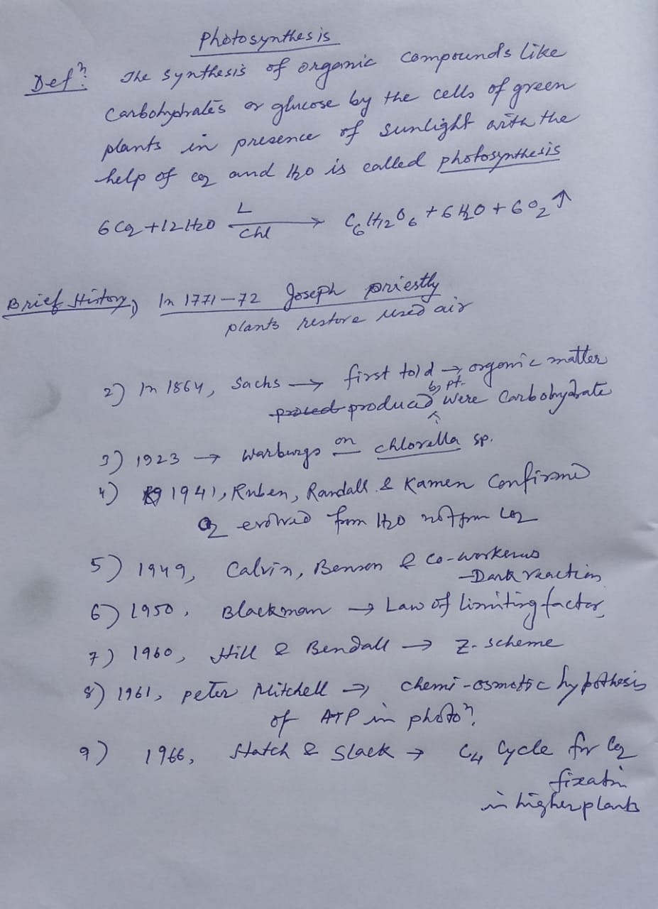

Slide 2
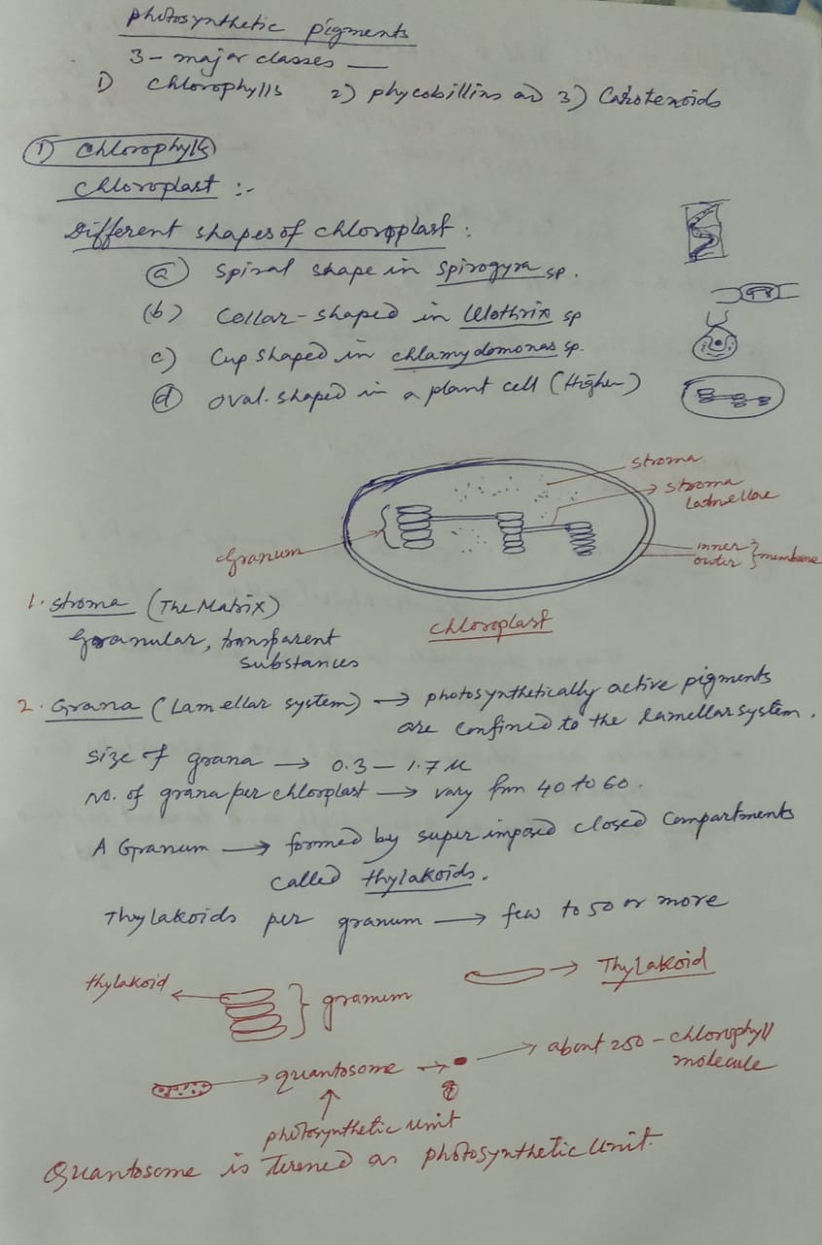

Slide 3
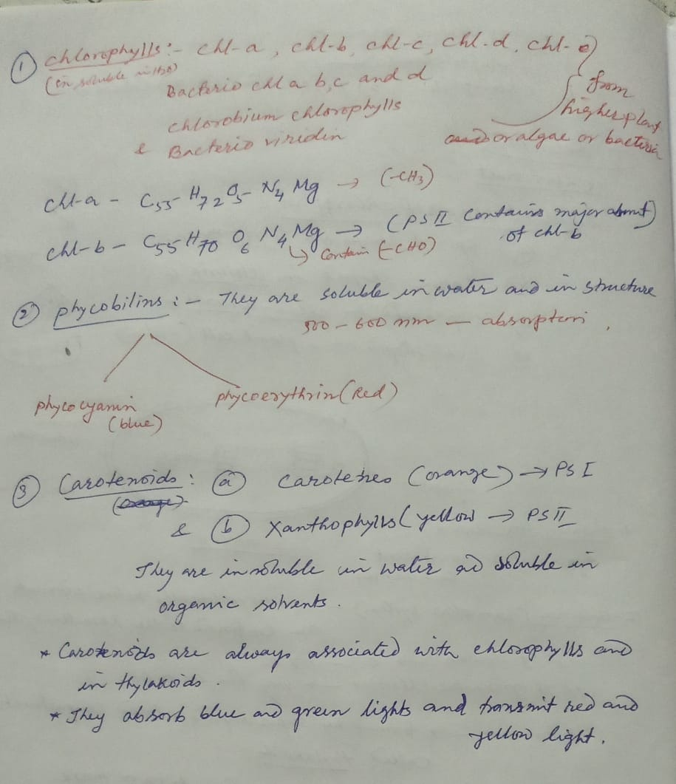

Slide 4
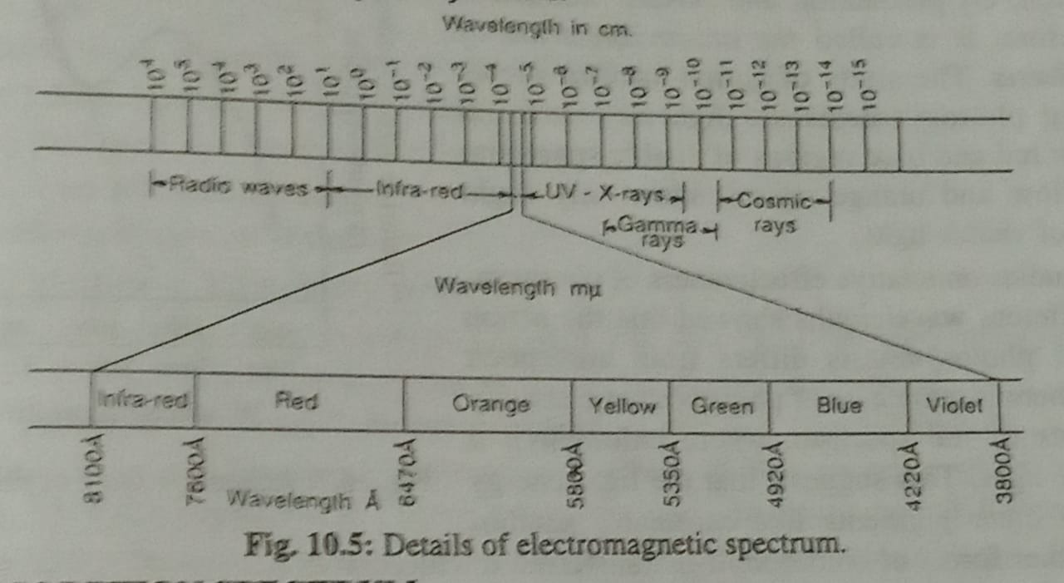

Slide 5
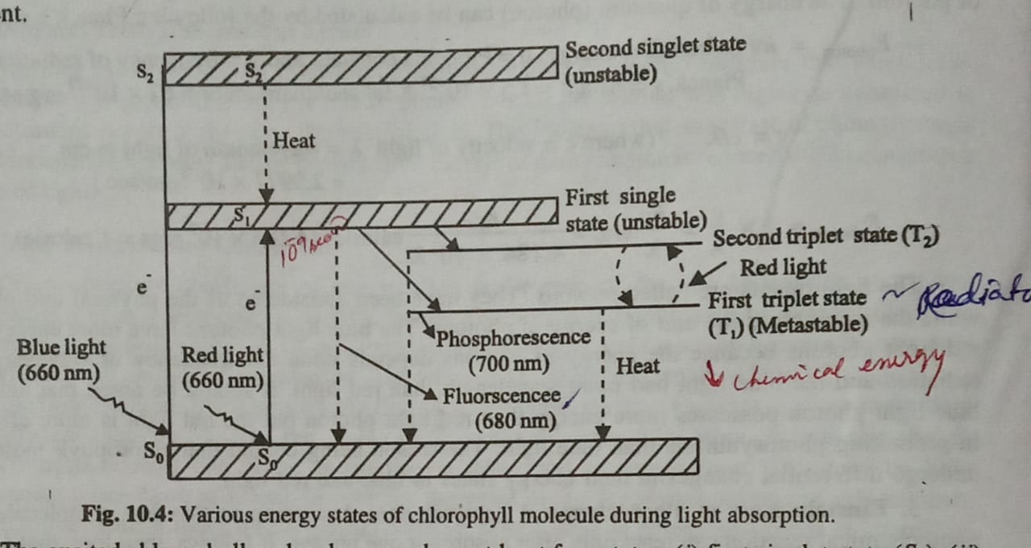

Slide 6
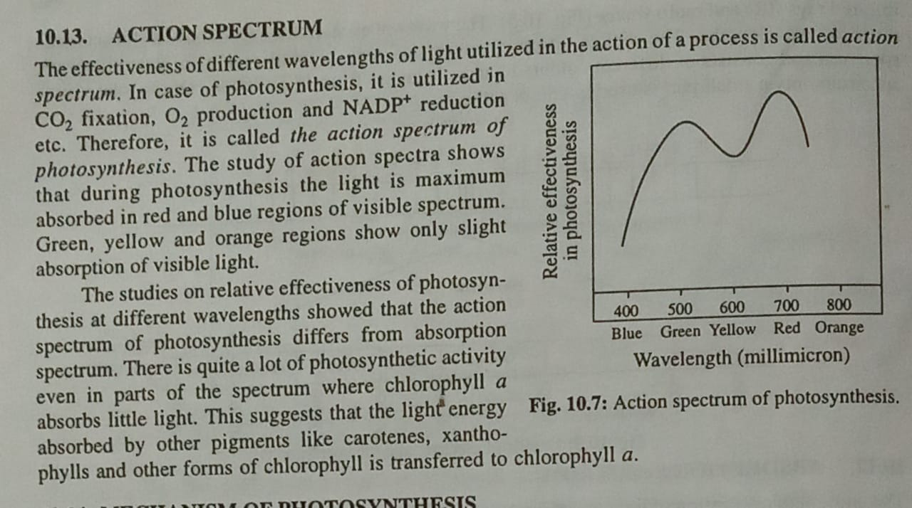

Slide 7
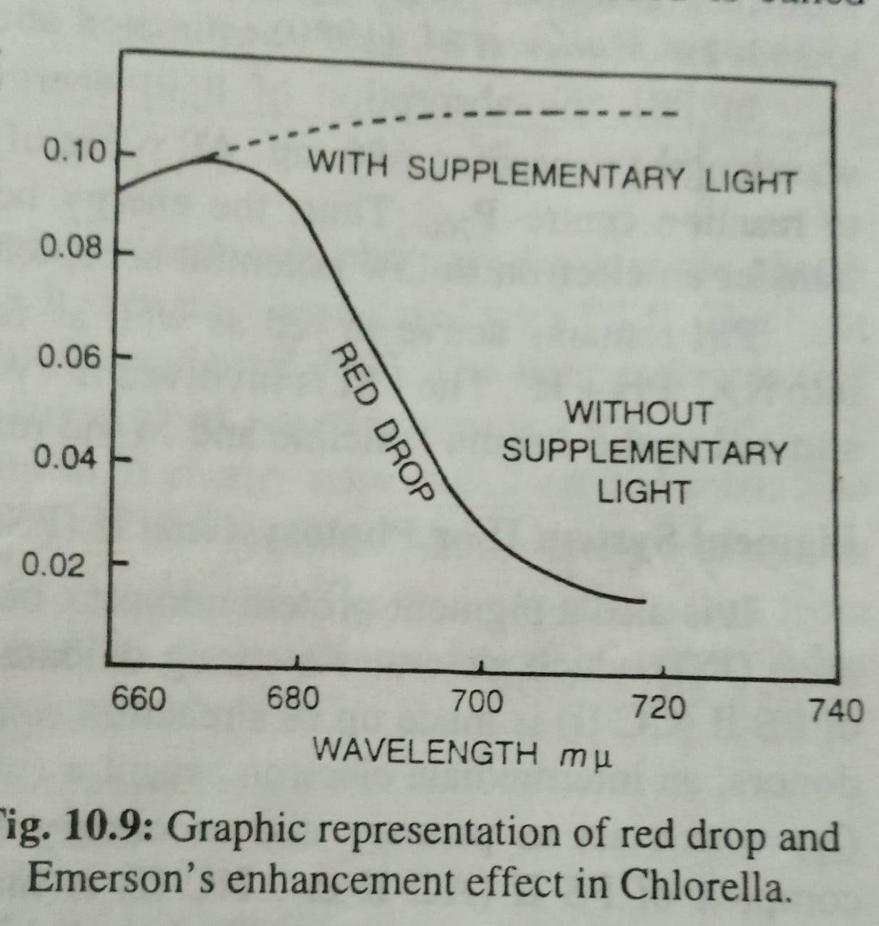

Slide 8
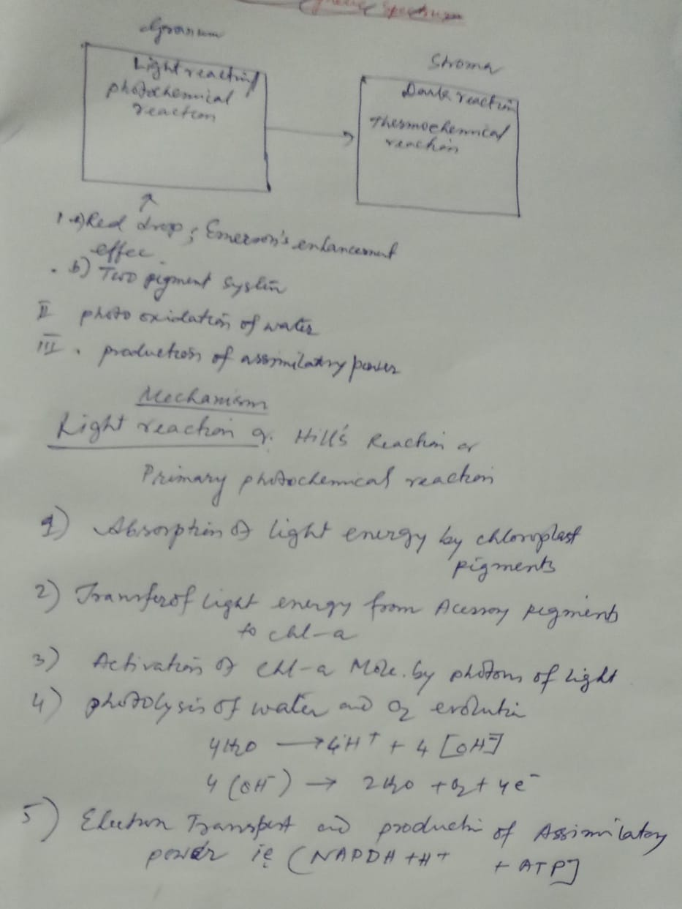

Slide 9
Steps of light reaction
These reactions occur within specialised membrane discs within the chloroplast called thylakoids and involve three steps:
Excitation of photosystems by light energy.
Production of ATP via an electron transport chain.
Reduction of NADP+ and
the photolysis of water.

Slide 11
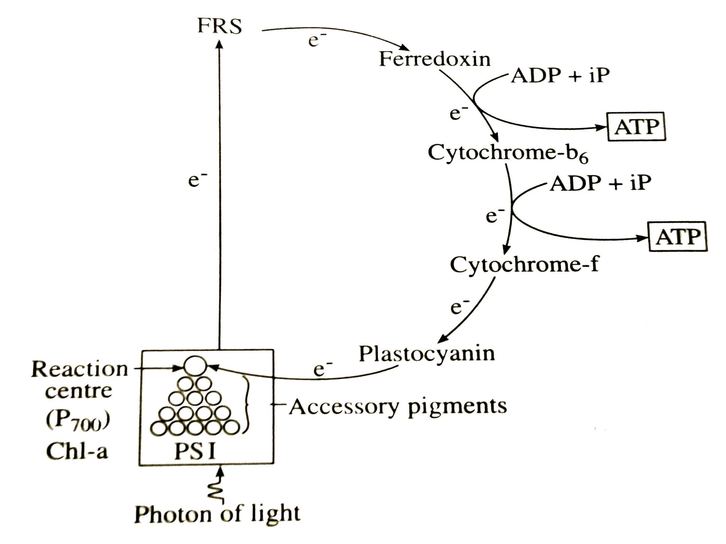

Slide 15
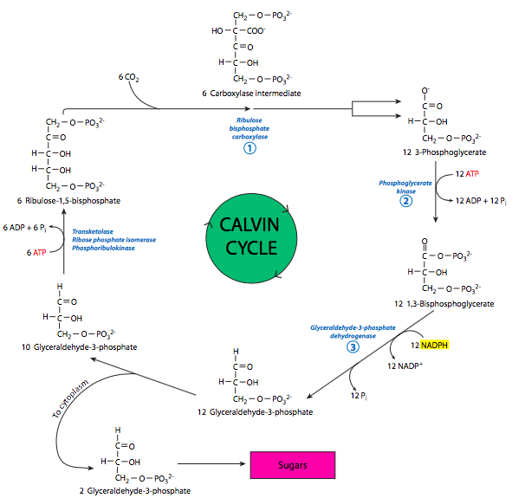

Slide 16
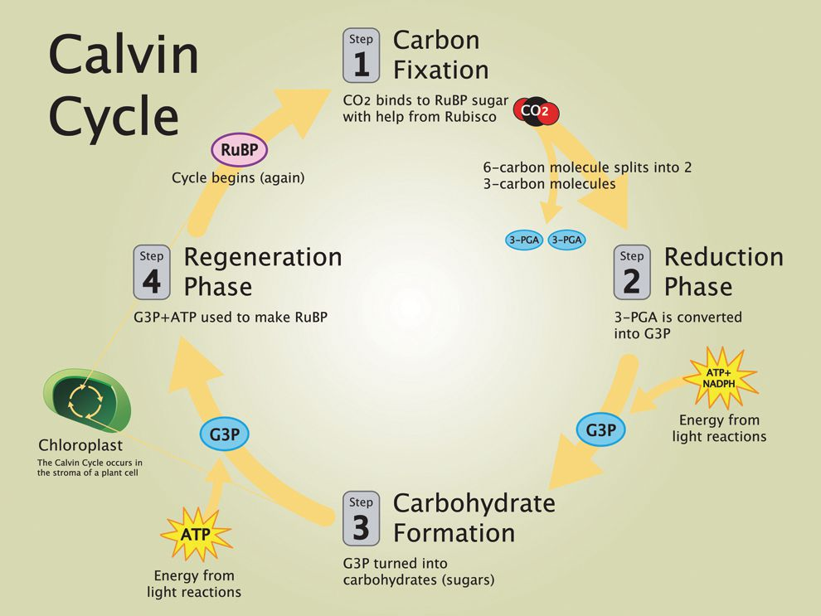

Slide 17
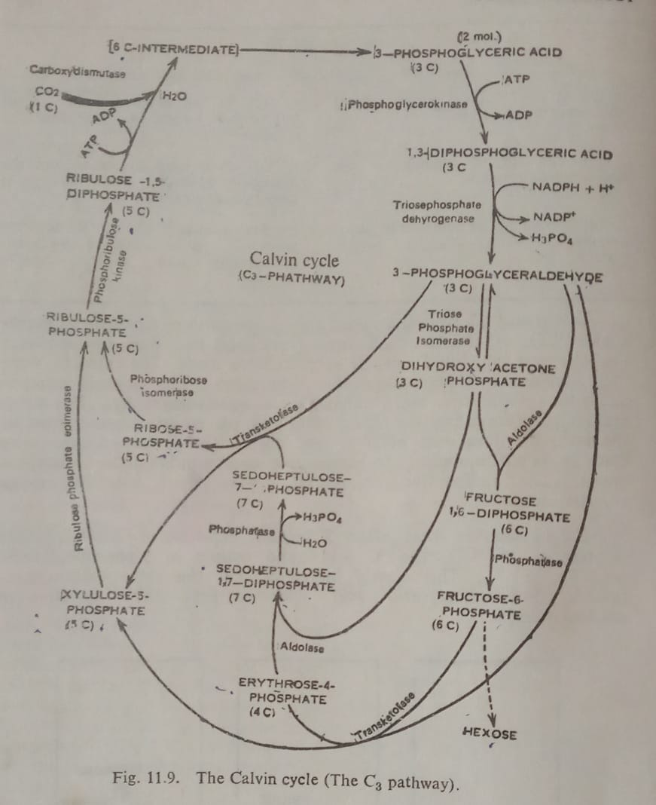

Slide 18
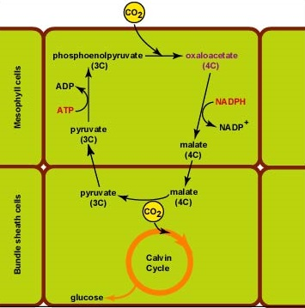

Slide 19
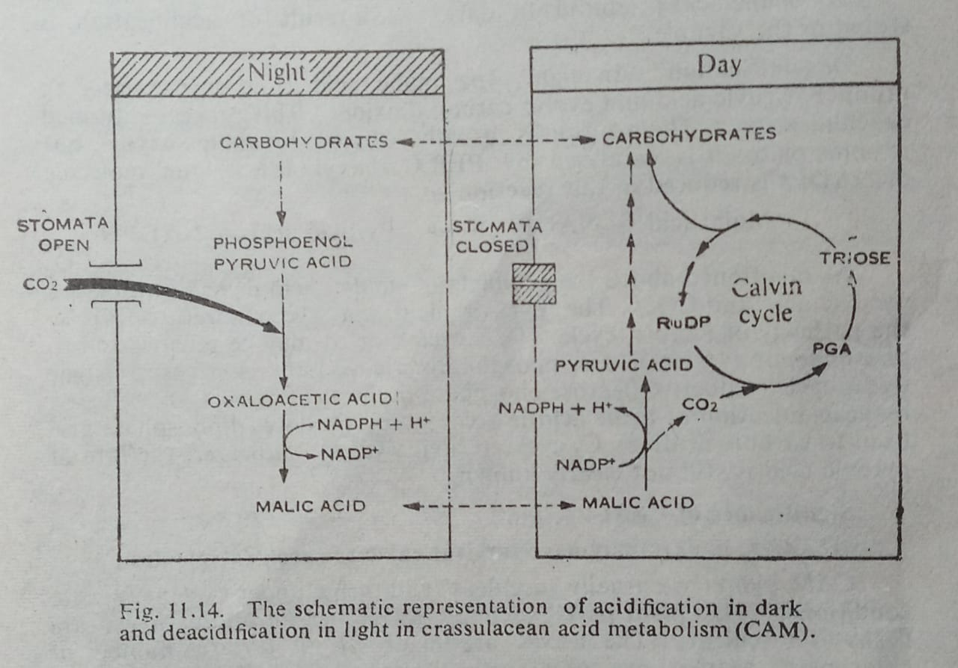

Slide 20
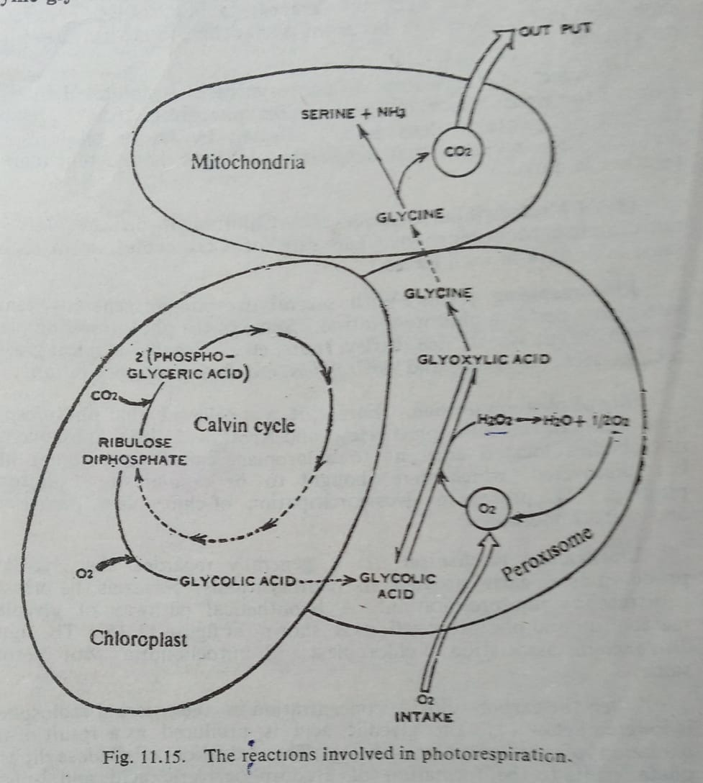

Slide 21
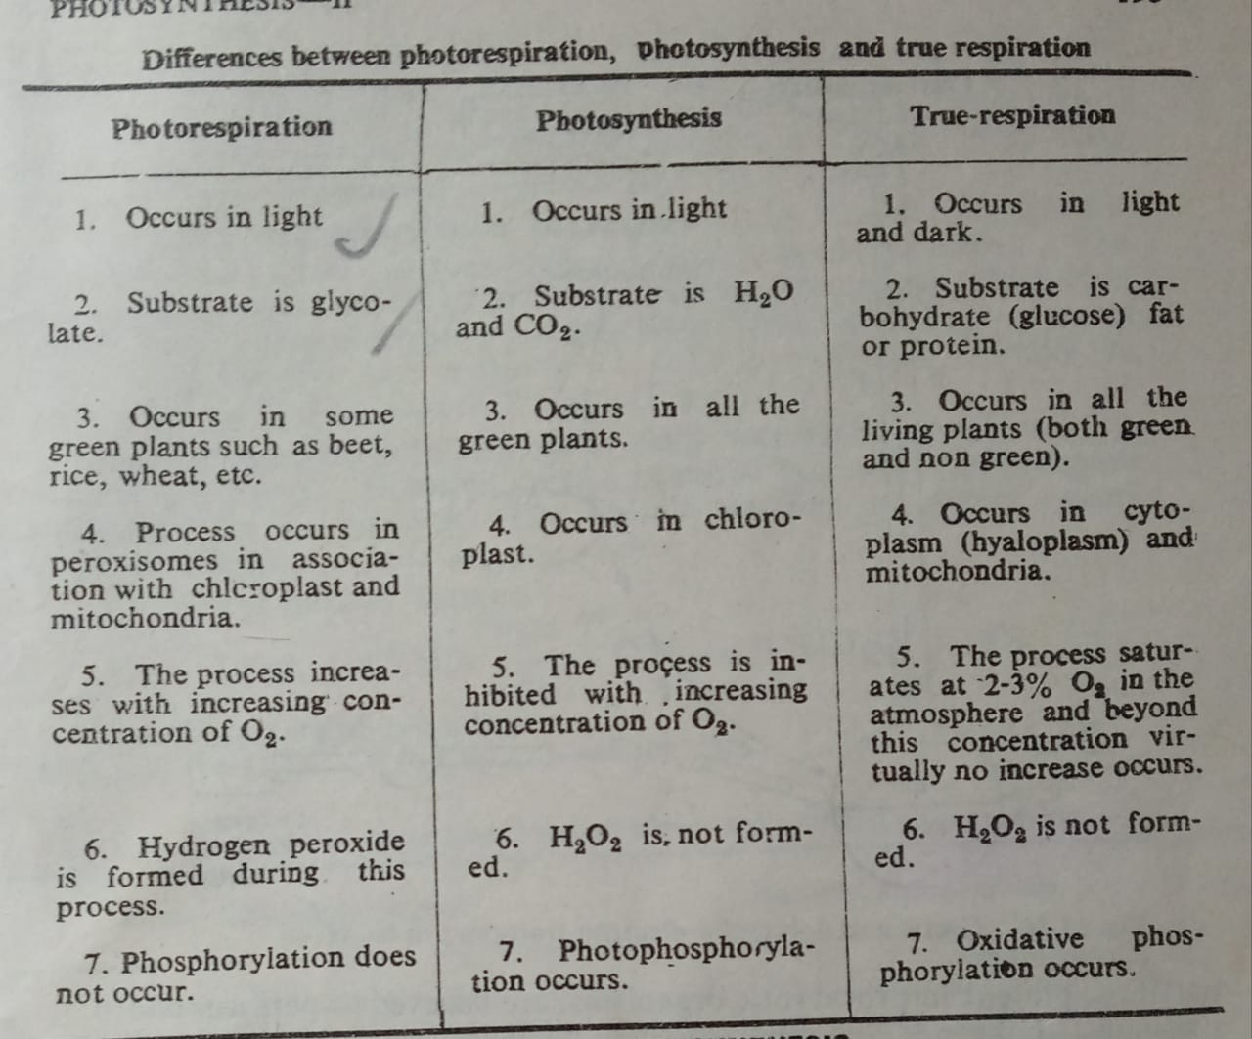

Slide 22
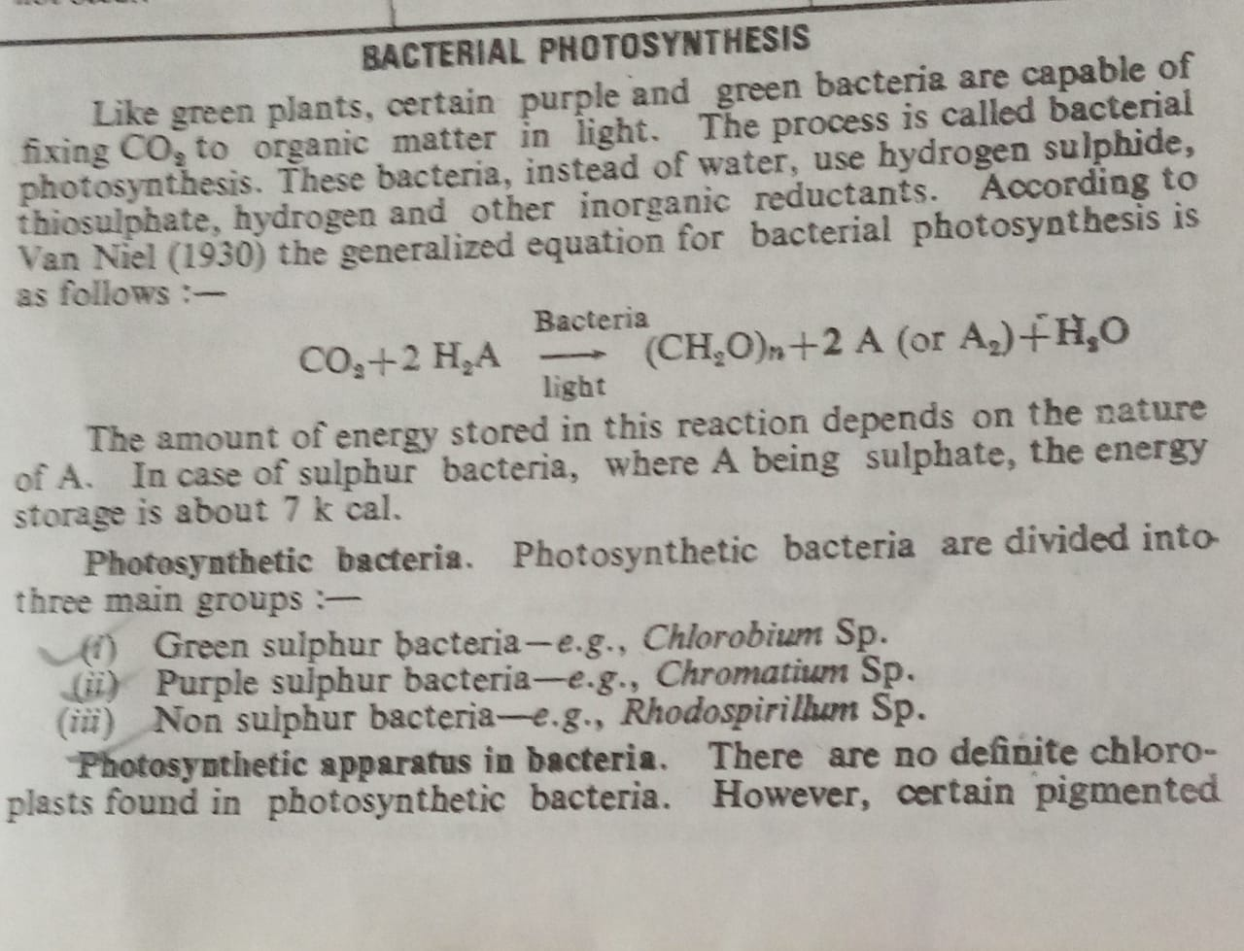

Slide 25
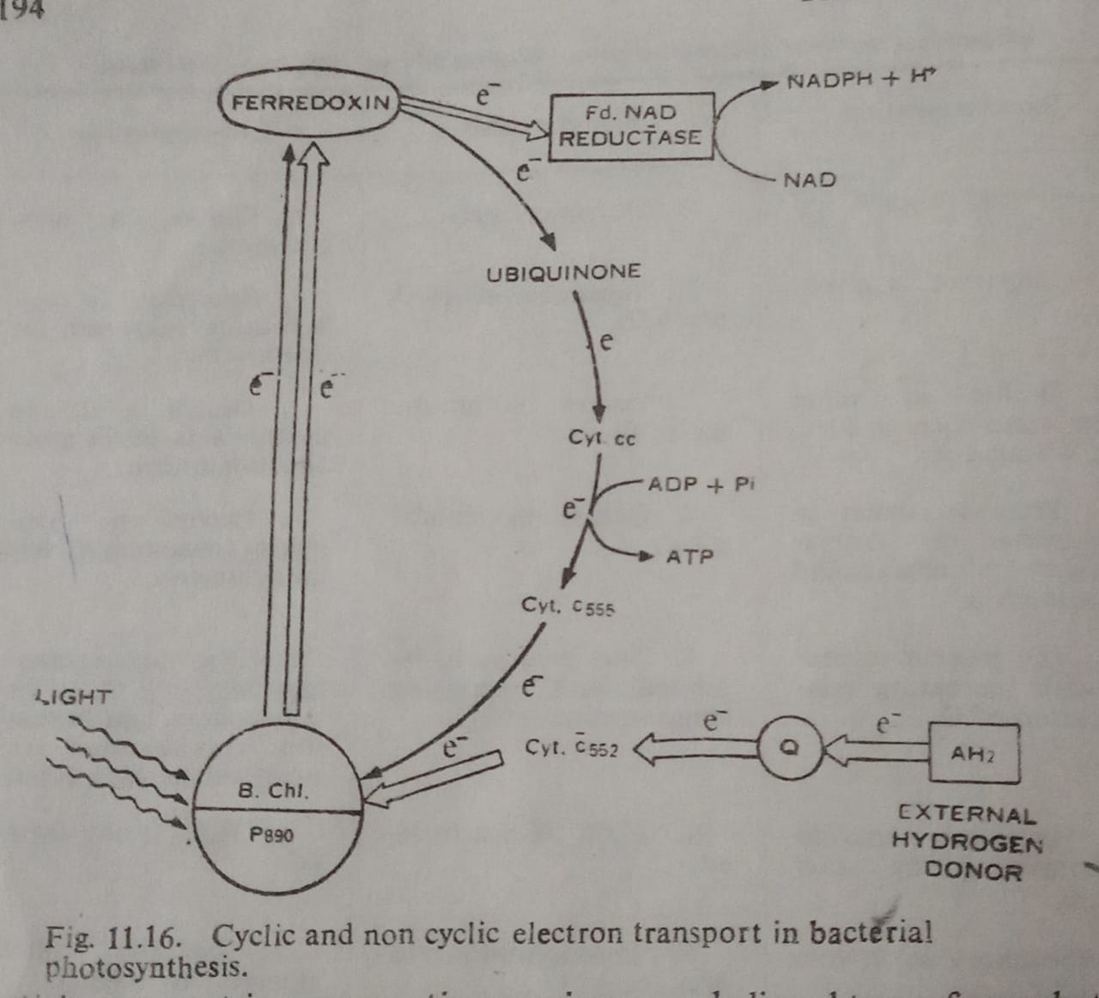

Slide 26
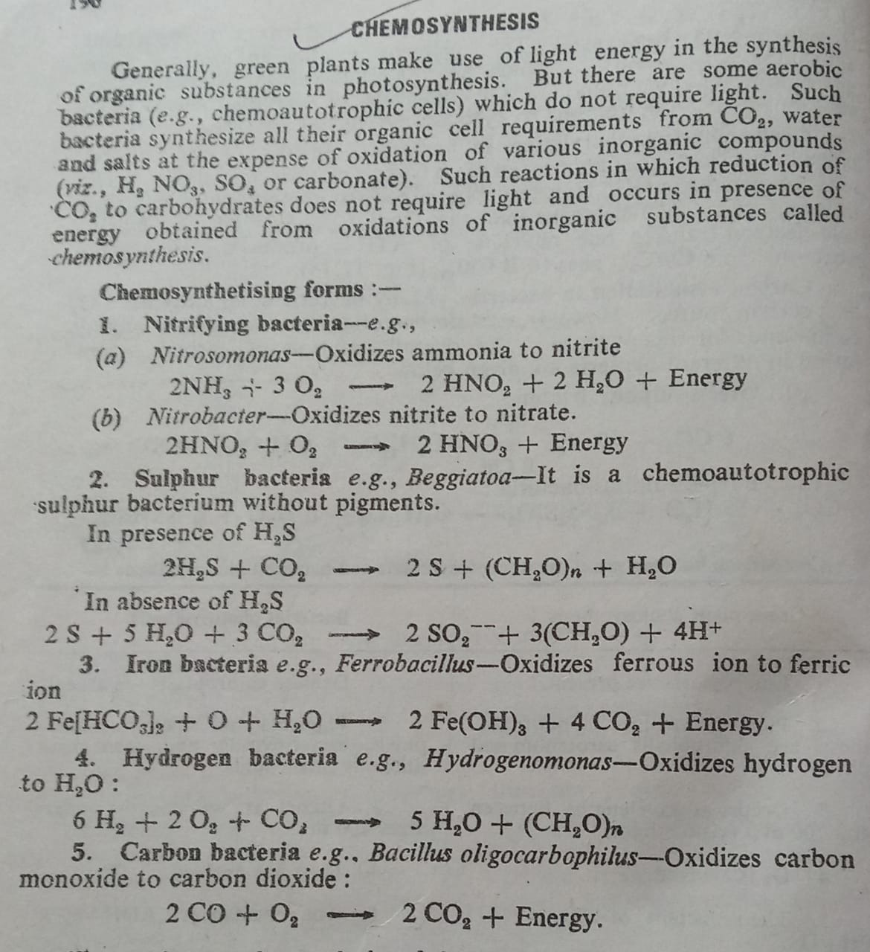

Slide 27
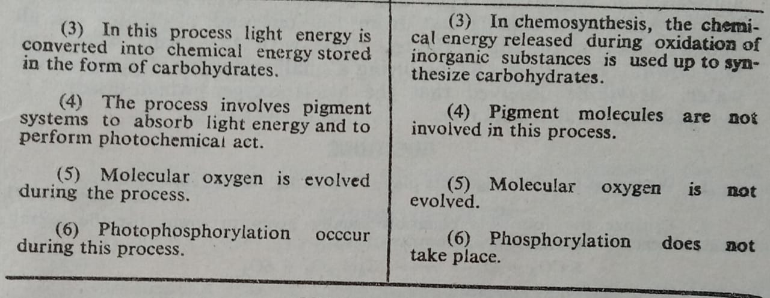

Slide 29
RESPIRATION
C₆H₁₂O₆ + 6O₂ 6CO₂ + 6H₂O + 674 K.Cal
A process in which the respiratory substrates (viz, Sucrose ,starch , other sugars; fats ;organic acid, proteins, etc) are broken down through oxidation ,releasing energy(ATP ) and CO₂ as a consequences.
Def:

Slide 30
RQ(respiratory quotient)=Volume of CO₂ released/ Volume of Oxygen absorbed
RQ=1, carbohydrate(unity)
RQ=0.7 Fats
RQ= 0.8-0.9 Protein
RQ=1.54-2.4 germinating seed, pea
RQ= Opuntia 1.33

Slide 31
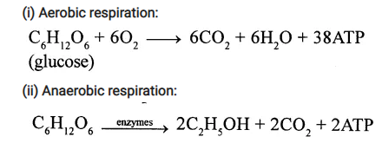

Slide 32
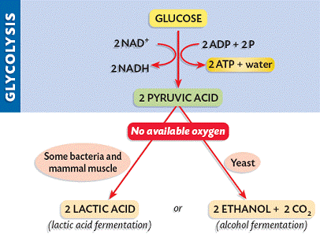

Slide 33
Glycolysis
(Gr: Glykos 5 Glucose, Lysis 5 Splitting) Glycolysis is a linear series of reactions in which 6-carbon glucose is split into two molecules of 3-carbon pyruvic acid. The enzymes which are required for glycolysis are present in the cytoplasm (Figure 14.6). The reactions of glycolysis were worked out in yeast cells by three scientists Gustav Embden (German), Otto Meyerhoff (German) and J Paranas (Polish) and so it is also called as EMP pathway. It is the first and common stage for both aerobic and anaerobic respiration. It is divided into two phases.
1. Preparatory phase or endergonic phase or hexose phase (steps 1-5).
2. Pay off phase or oxidative phase or exergonic phase or triose phase (steps 6-10).

Slide 35
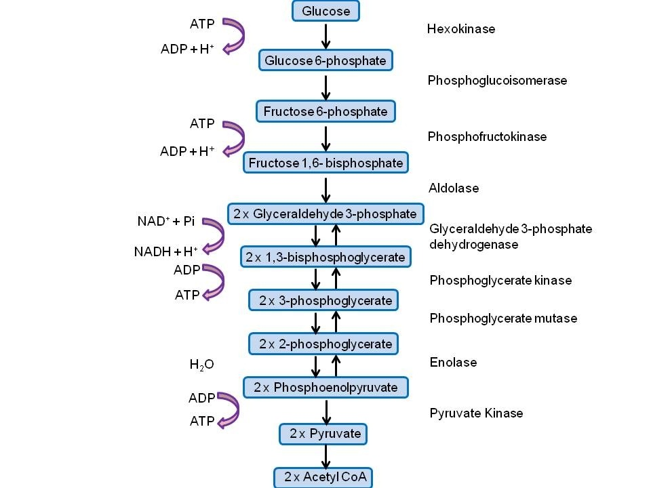

Slide 37
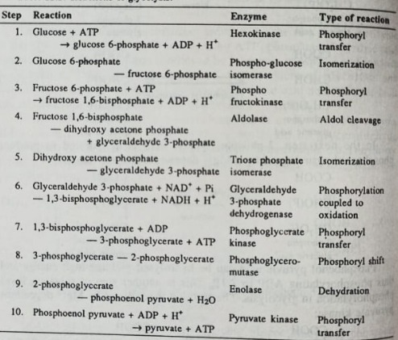

Slide 38
Step | Reaction | ΔG°' / (kJ/mol) | ΔG / (kJ/mol)
1 | Glucose + ATP⁴⁻ → Glucose-6-phosphate²⁻ + ADP³⁻ + H⁺ | −16.7 | −34
2 | Glucose-6-phosphate²⁻ → Fructose-6-phosphate²⁻ | 1.67 | −2.9
3 | Fructose-6-phosphate²⁻ + ATP⁴⁻ → Fructose-1,6-bisphosphate⁴⁻ + ADP³⁻ + H⁺ | −14.2 | −19
4 | Fructose-1,6-bisphosphate⁴⁻ → Dihydroxyacetone phosphate²⁻ + Glyceraldehyde-3-phosphate²⁻ | 23.9 | −0.23
5 | Dihydroxyacetone phosphate²⁻ → Glyceraldehyde-3-phosphate²⁻ | 7.56 | 2.4

Slide 39
6
Glyceraldehyde-3-phosphate²⁻ + P_{i}²⁻ + NAD⁺ → 1,3-Bisphosphoglycerate⁴⁻ + NADH + H⁺
7
1,3-Bisphosphoglycerate⁴⁻ + ADP³⁻ → 3-Phosphoglycerate³⁻ + ATP⁴⁻
−18.9
0.09
8
3-Phosphoglycerate³⁻ → 2-Phosphoglycerate³⁻
4.4
0.83
9
2-Phosphoglycerate³⁻ → Phosphoenolpyruvate³⁻ + H₂O
1.8
1.1
10
Phosphoenolpyruvate³⁻ + ADP³⁻ + H⁺ → Pyruvate⁻ + ATP⁴⁻
−31.7
−23.0

Slide 41
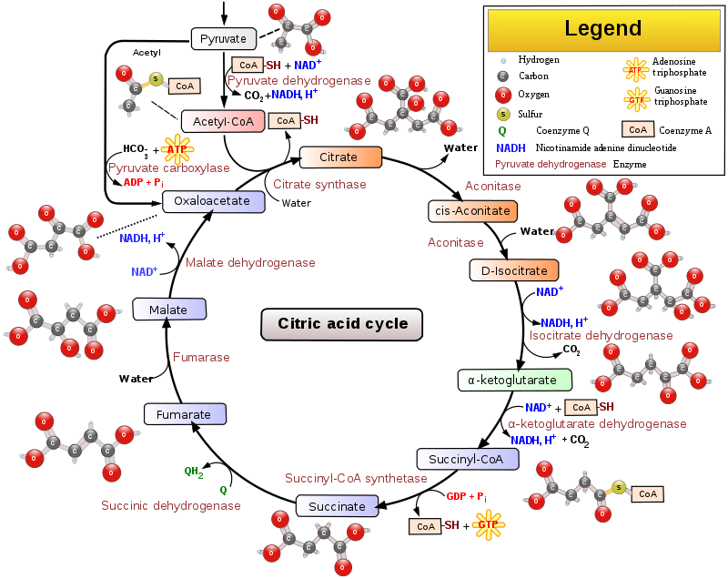

Slide 42
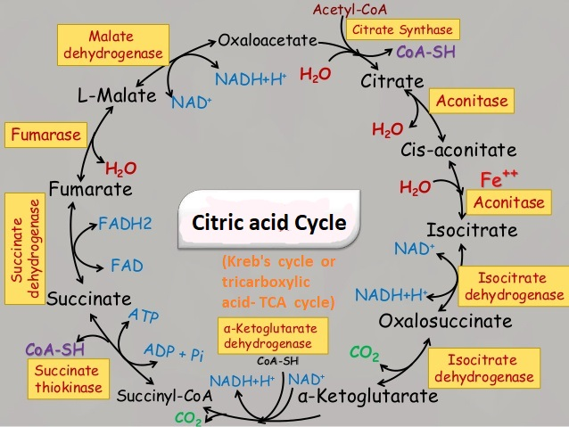

Slide 43
The Kreb cycle is also known as the Citric acid cycle
or TCA( Tricarboxylic Acid ) Cycle
because the Citric Acid has 3-COOH groups
and is the first product of the Krebs cycle.

Slide 44
. Oxidative phosphorylation is the process
in which ATP is formed as a result of
the transfer of electrons from NADH or FADH ₂ to O ₂
by a series of electron carriers. This process, which takes place in mitochondria,
is the major source of ATP in aerobic organisms .
For example, oxidative phosphorylation
generates 26 of the 30 molecules of ATP
that are formed when glucose is
completely oxidized to CO₂ and H₂O.

Slide 45
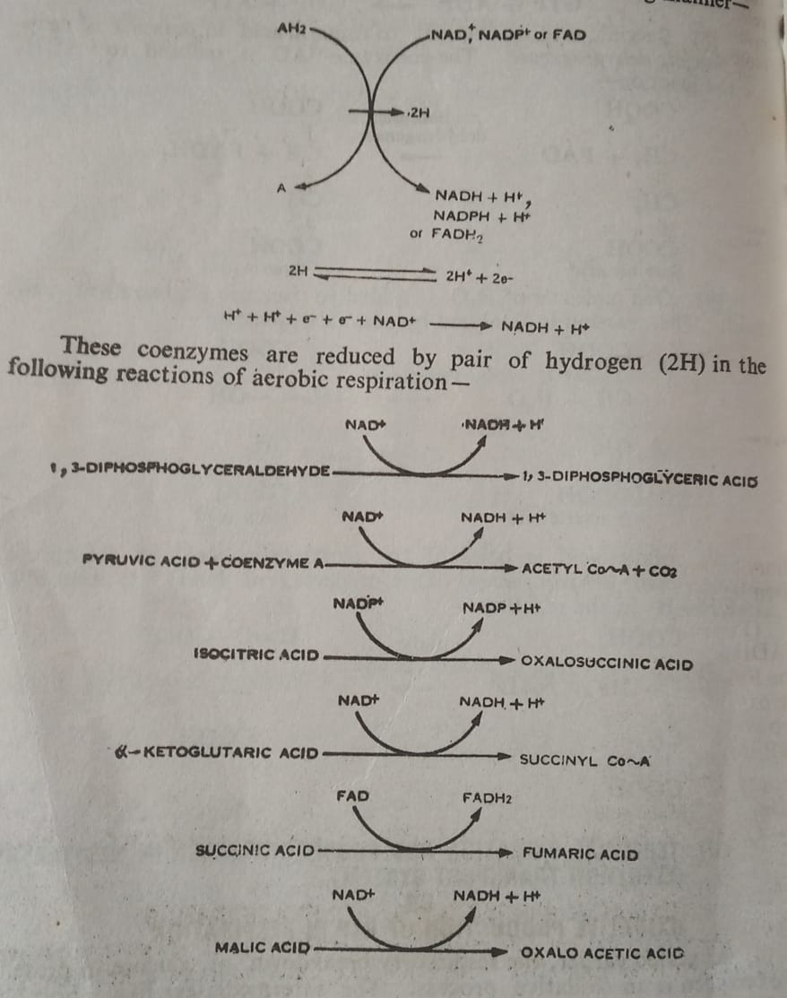

Slide 46
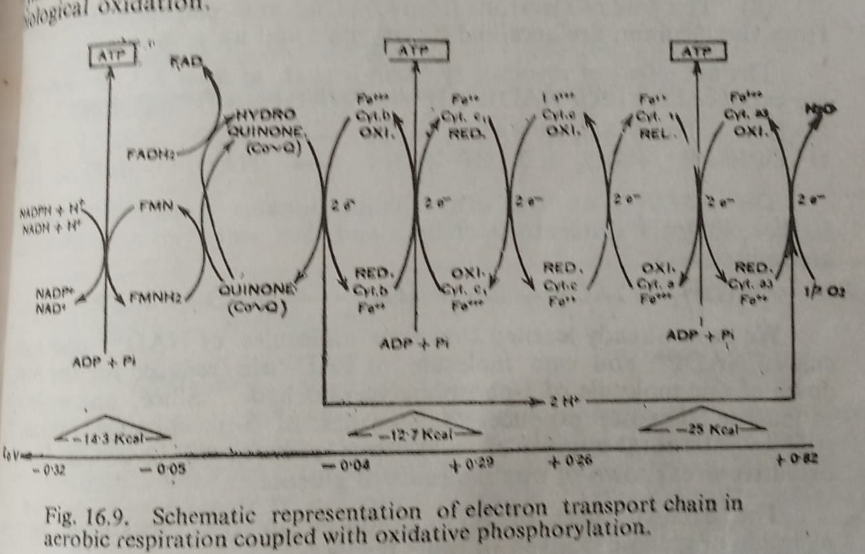

Slide 47
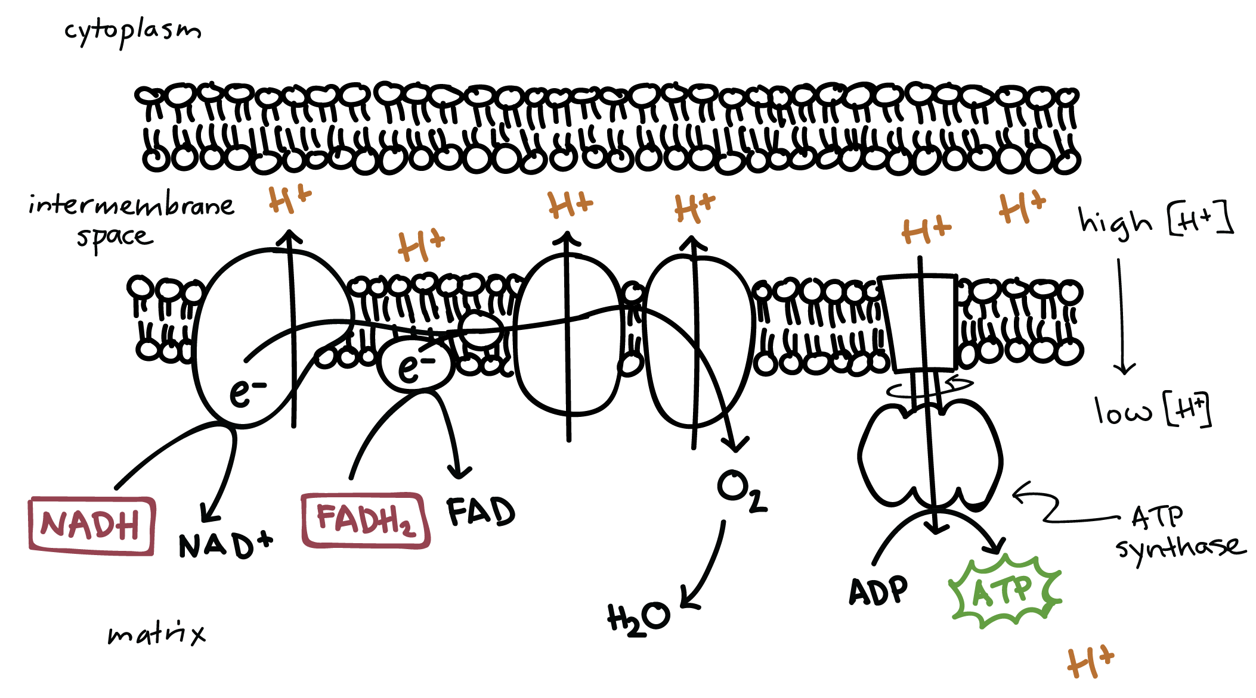
Oxidative Phosphorylation

Slide 48
The electron transport chain is a series of proteins and organic molecules found in the inner membrane of the mitochondria. Electrons are passed from one member of the transport chain to another in a series of redox reactions. Energy released in these reactions is captured as a proton gradient, which is then used to make ATP in a process called chemiosmosis. Together, the electron transport chain and chemiosmosis make up oxidative phosphorylation. The key steps of this process, shown in simplified form in the diagram above, include:
Delivery of electrons by NADH and FADH_22​start subscript, 2, end subscript. Reduced electron carriers (NADH and FADH_22​start subscript, 2, end subscript) from other steps of cellular respiration transfer their electrons to molecules near the beginning of the transport chain. In the process, they turn back into NAD^++start superscript, plus, end superscript and FAD, which can be reused in other steps of cellular respiration.
Electron transfer and proton pumping. As electrons are passed down the chain, they move from a higher to a lower energy level, releasing energy. Some of the energy is used to pump H^++start superscript, plus, end superscript ions, moving them out of the matrix and into the intermembrane space. This pumping establishes an electrochemical gradient.
Splitting of oxygen to form water. At the end of the electron transport chain, electrons are transferred to molecular oxygen, which splits in half and takes up H^++start superscript, plus, end superscript to form water.
Gradient-driven synthesis of ATP. As H^++start superscript, plus, end superscript ions flow down their gradient and back into the matrix, they pass through an enzyme called ATP synthase, which harnesses the flow of protons to synthesize ATP.

Slide 49
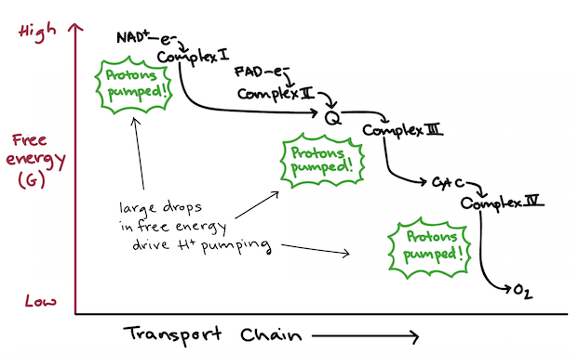
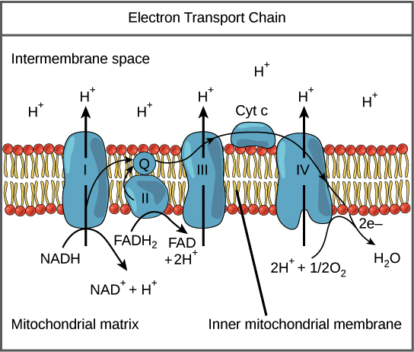

Slide 50
Chemiosmosis is the movement of ions across a semipermeable membrane bound structure, down their electrochemical gradient. An example of this would be the formation of adenosine triphosphate (ATP) by the movement of hydrogen ions (H⁺) across a membrane during cellular respiration or photosynthesis.
An ion gradient has potential energy and can be used to power chemical reactions when the ions pass through a channel (red).
Hydrogen ions, or protons, will diffuse from an area of high proton concentration to an area of lower proton concentration, and an electrochemical concentration gradient of protons across a membrane can be harnessed to make ATP. This process is related to osmosis, the diffusion of water across a membrane, which is why it is called "chemiosmosis".

Slide 51
ATP synthase is the enzyme that makes ATP by chemiosmosis. It allows protons to pass through the membrane and uses the free energy difference to phosphorylate adenosine diphosphate (ADP), making ATP. The generation of ATP by chemiosmosis occurs in mitochondria and chloroplasts, as well as in most bacteria and archaea, an electron transport chain pumps H⁺ ions (protons) in the thylakoid spaces through thylakoid membranes to stroma (fluid). The energy from the electron movement through electron transport chains cross through ATP synthase which allows the proton to pass through them and use this free energy difference to photophosphorylate ADP making ATP.

Slide 52
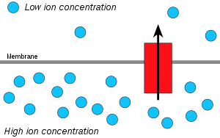

Slide 53
